Slide 1
Modelling Cancer Diagnoses
By Ishan Sharma

Slide 2
Overview
Cancer is a complicated issue which affects millions of people
It is very hard to predict it, but prediction is incredibly important when it comes to treatment
By creating a model considering geography and temporal indices, I may be able to predict it

Slide 3
Data processing
From the Institute for Health Metrics and Evaluation
Centerpiece is cancer mortality rate by county, divided into several spreadsheets by state and sheets within it by type of cancer
37 types of cancer
With mortality rate by year from 1980-2014 for each
Additionally contains margin of error between mortality rates
More data but this but this is the main one

Slide 4
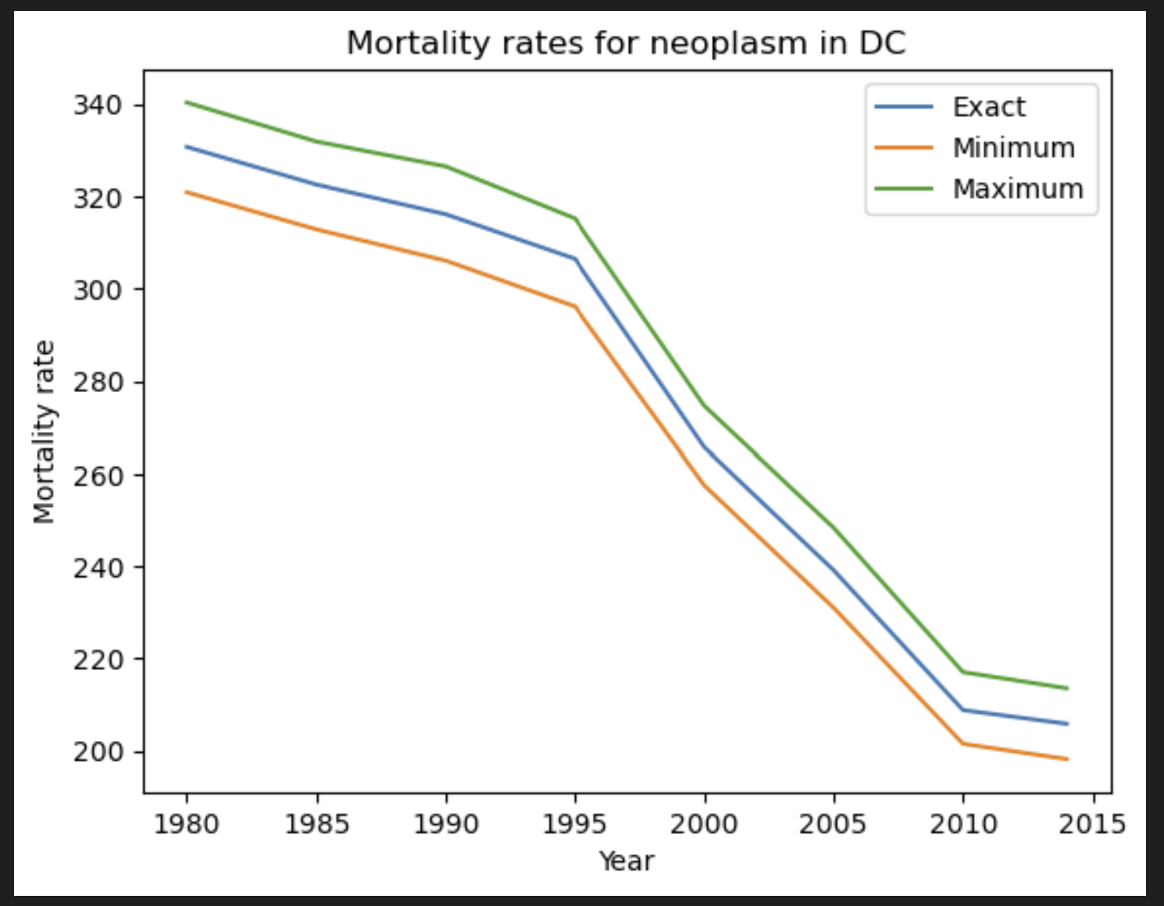
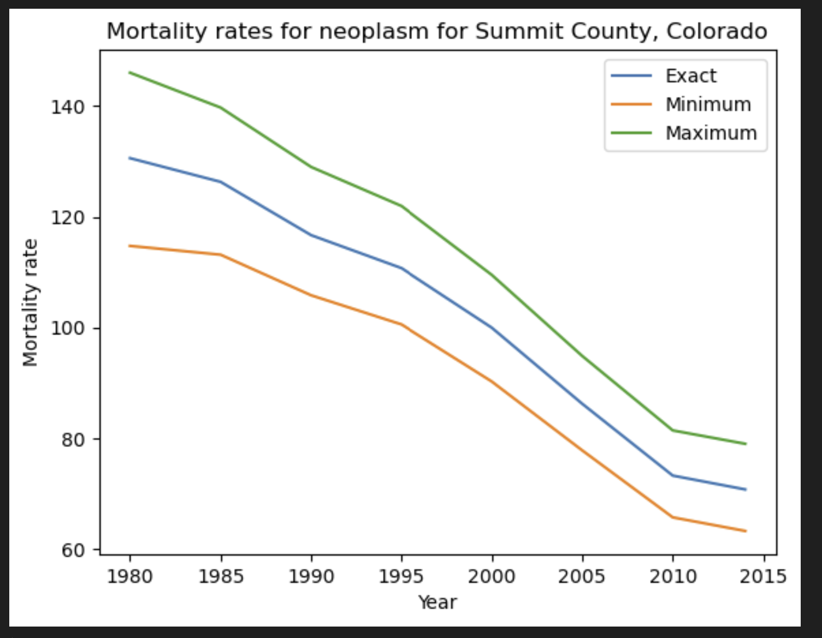
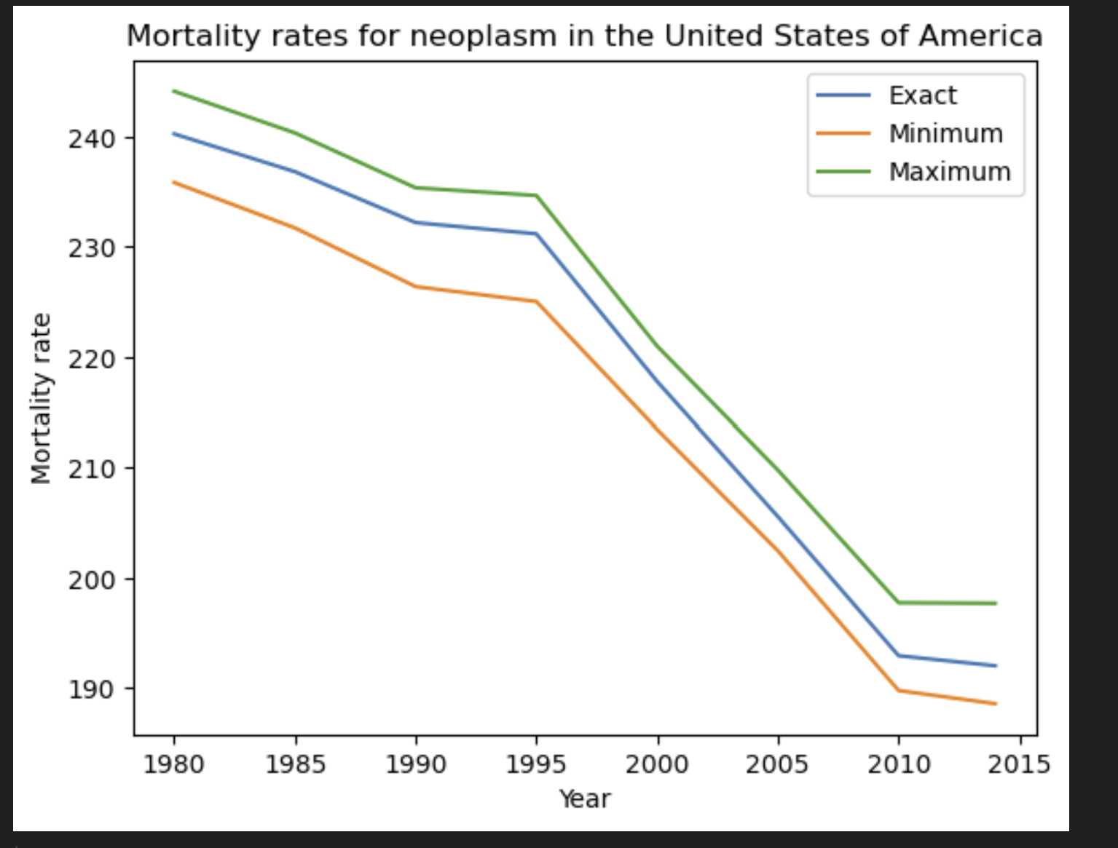
EDA
Investigated all 37 different types of cancer in national spreadsheet
Found several spatial distributions in cancer, with minimum and maximum counties correlated with one another
Findings
Summit County, Colorado consistently appears as a county with the lowest mortality rate – it is consistently a leader in development
Oglala Lakota County, South Dakota consistently appears as a county with the highest mortality rate – has to do with demography
Utah consistently appears as a state with the lowest mortality rate
The District of Columbia consistently appears as a state with the highest mortality rate, some improvement in more recent years notwithstanding
Error bars vary dramatically and with very little pattern, but I shall incorporate it into my modelling

Slide 5
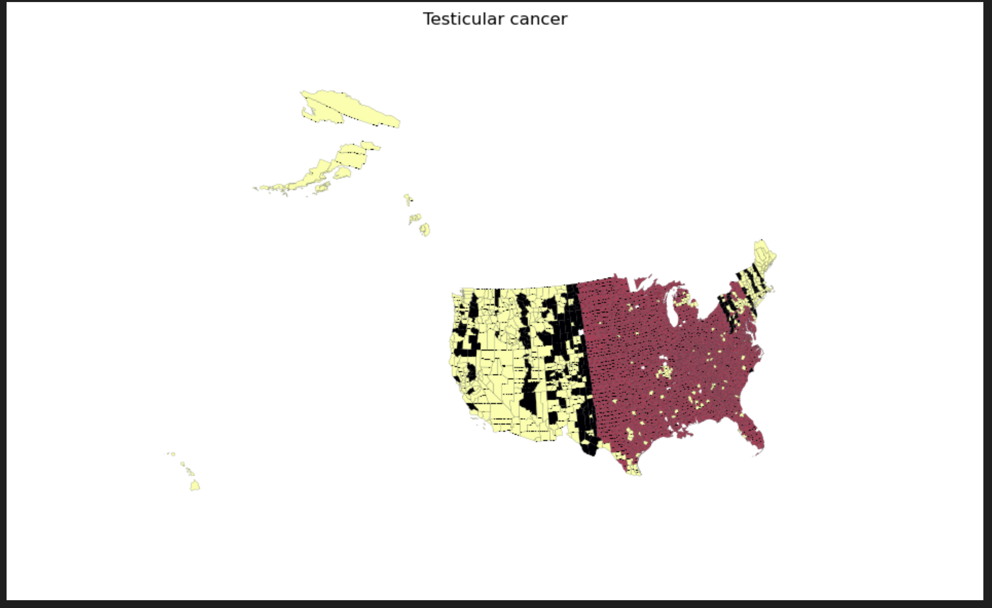
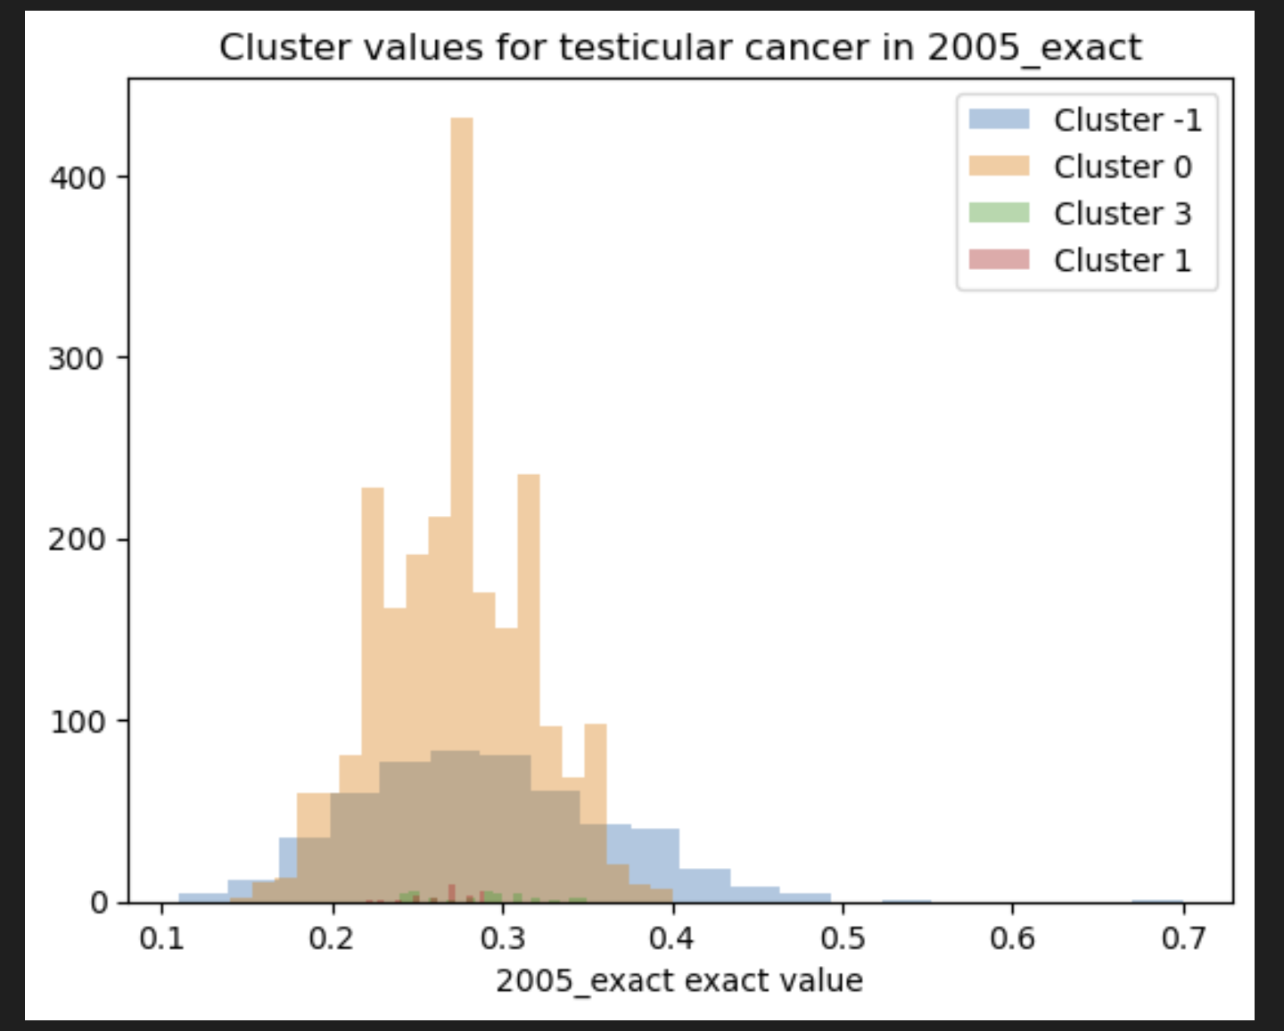
Model comparison and interpretation
Constructed a series of clusters for the various types of cancer
Revealed the division of the US into two regions – east and west – for several types
East region has a noticeably higher rate than west region
Revealing of lower density, perhaps

Slide 6
Product
A portal in which a user inputs data about themselves (chiefly geographic)
From there, the user would receive their likelihood of different types of cancers

Slide 7

Thank you!

